Slide 1
Aspect Oriented Programming

Slide 2
Aspect Oriented Programming Terms
Cross-cutting concern
Aspect
Join Point
Pointcut
Advice
Notes:
If you lookup about aspect oriented programming in the textbook or through web search, you will see these terms.
But when you are learning about this for the first time, I think they can be over-whelming and not too useful to understand the definitions at the very beginning.
So instead of explaining the textbook definition of each of these, I will be explaining these as we go over some examples.

Slide 3
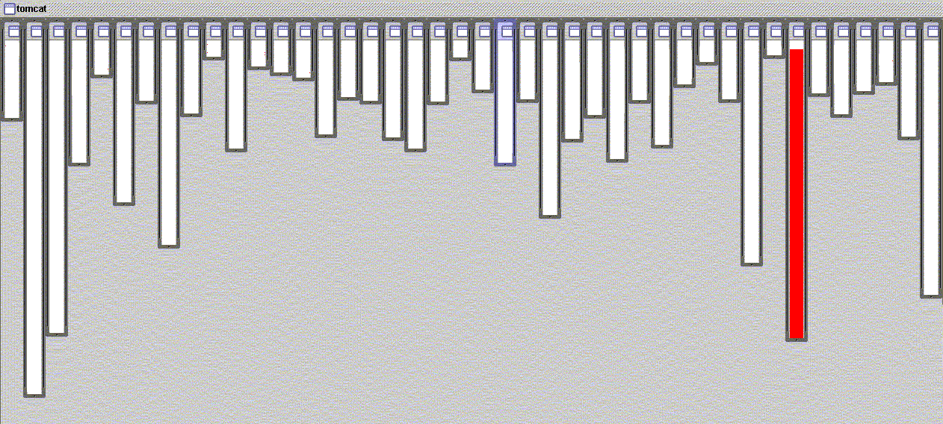
Motivation
Apache Tomcat code base
Column = a class
Length = LOC
XML parsing
Image from AspectJ tutorial slides
XML Parsing in org.apache.tomcat
Notes:
But before I get into the details of AOP, let’s understand the motivation behind AOP and why such a thing is needed and how it can help us.
This shows a visual representation of an open source project called Apache Tomcat.
Each column represents a Java class and the length of the column represents the Lines of Code.
If you look at this XML parsing class, the red column shows the lines relevant for doing XML parsing. All of these lines exist solely for XML parsing.
This is an example of a highly modular class, and it can be easily reused in other projects.
Usually this is how you want your class to look like because it promotes better reusability and understandability.

Slide 4
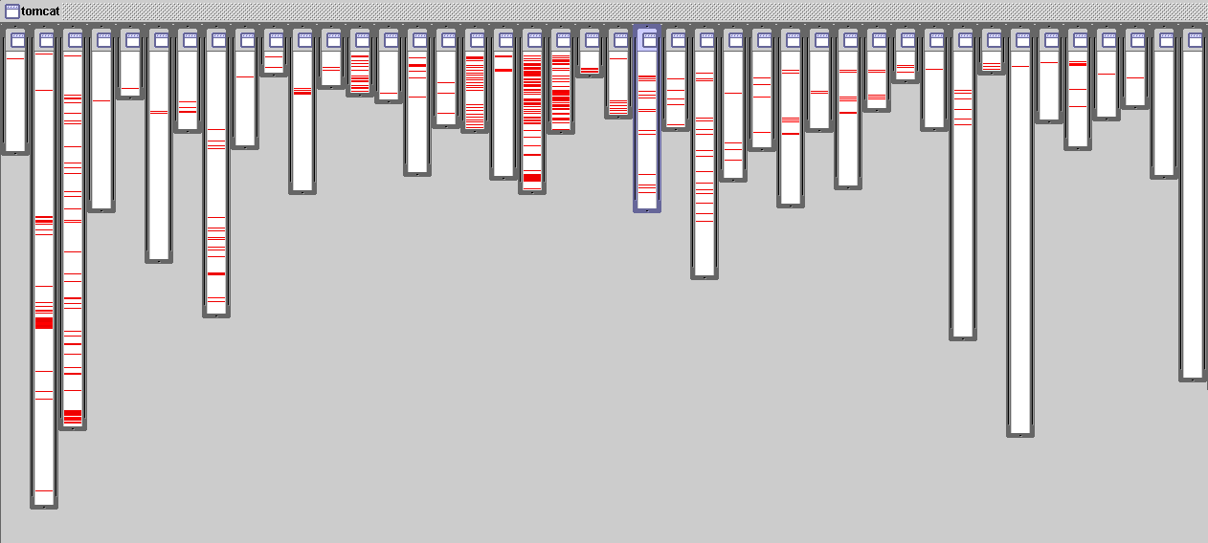
Motivation
Apache Tomcat code base
Logging is not modularized
Image from AspectJ tutorial slides
All log statements in org.apache.tomcat
Notes:
Now let’s look at where logging statements happens in the code.
By logging, I simply mean a line of code that prints a debug statement and saves to a file.
As you can see, logging statements are not modularized and exists all over the code and there is no single place for logging.
What is the problem with this?
Well, imagine that you are using a log4j library to do your logging. And one day, requirements change to use a different logging library.
Then you need to go to every logging statement and change that line to use the new library.
This is too time consuming and not a good way to maintain software.

Slide 5
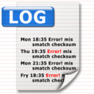




Repetitiveness
public void validateOrder(String orderId) {
log.info("Executing validateOrder with orderId: " + orderId);
validationService.validate(orderId);
}
public PaginatedOrderHistory getOrderHistory(String customerId) {
log.info("Executing getOrderHistory with customerID: " + customerId);
final long startTime = System.currentTimeMillis();
Customer c = getCustomer(customerId);
if (customerExists(c)) {
paginatedOrderHistory = dao.getOrderHistoryForCustomer(customerId);
}
final long stopTime = System.currentTimeMillis();
metrics.addTime("getOrderHistory", stopTime - startTime);
return paginatedOrderHistory;
}
public long getOrderCount(String customerId) {
log.info("Executing getOrderCount for customerId: " + customerId);
return dao.getOrderCount(customerId);
}
Notes:
Here is some sample code that shows the redundant logging statements occurring all over the code base.
Such redundant code that is doing the same task, is called a cross cutting concern.
Another example of a cross cutting concern is measuring the execution time of a method.
Here you start the timer, do some work, then stop the timer, and record how long your method took to execute.
This is a common functionality that is shared by many methods but to have such a timer, you have to repeat the same code to other methods.
Any common functionality that is repeating in your code base is a cross cutting concern.
Now imagine you have hundreds of methods and you want to measure the execution time of all of them.
You would have to repeat the same code for hundreds of methods.

Slide 6
What if ?
public void validateOrder(String orderId) {
log.info("Executing validateOrder with orderId: " + orderId);
validationService.validate(orderId);
}
public PaginatedOrderHistory getOrderHistory(String customerId) {
log.info("Executing getOrderHistory with customerID: " + customerId);
final long startTime = System.currentTimeMillis();
Customer c = getCustomer(customerId);
if (customerExists(c)) {
paginatedOrderHistory = dao.getOrderHistoryForCustomer(customerId);
}
final long stopTime = System.currentTimeMillis();
metrics.addTime("getOrderHistory", stopTime - startTime);
return paginatedOrderHistory;
}
public long getOrderCount(String customerId) {
log.info("Executing getOrderCount for customerId: " + customerId);
return dao.getOrderCount(customerId);
}
Notes:
Now, what if there was a way to extract all the repeating code to somewhere else?
And somehow automatically inject the repeating code at places that need them.
This will result in having less code so that you could simply focus on your business logic.
Look at how readable this code is.
So do to something like this, a few engineers at Xerox invented what’s called AOP.

Slide 7
Aspect Oriented Programming
Proposes new construct called Aspect
Componentize cross-cutting concerns inside an aspect
Stop writing the same code
Notes:
AOP is a programming paradigm invented in 1998,
where it proposes to complement your programming language with a new construct called Aspect.
It aims to componentize cross cutting concerns inside an aspect.
With AOP the goal is to stop writing the same code and let aspect handle it for you.

Slide 8
Logging Aspect
@Aspect
public class LoggingAspect {
@Pointcut("execution(public * *(..))")
public void publicMethod() {}
@Before("publicMethod()")
public void addLog( final JoinPoint joinPoint ) {
System.out.println("Executing: ” + joinPoint.getSignature());
Object[] arguments = joinPoint.getArgs();
for (Object argument : arguments) {
System.out.println(argument.getClass().getSimpleName() + " = " + argument);
}
}
}
Pointcut = set of Join Points
Advice
Aspect = modularized cross cutting concern
Join point = points in the execution of a program. Ex) method call, method execution, exception handler execution
Pointcut = define points where extra logic will be applied
Advice = extra logic to be executed (@Before, @After, @Around)
Notes:
So this is what an Aspect looks like in AspectJ. I am using java specific example but AOP is implemented in other languages as well but the concept is the same.
Let me first go over some terminology.
Before – execute extra logic before method is executed
After – execute extra logic after method is executed
Around – Around is a special advice you can control when a method is executed and control what to return.

Slide 9
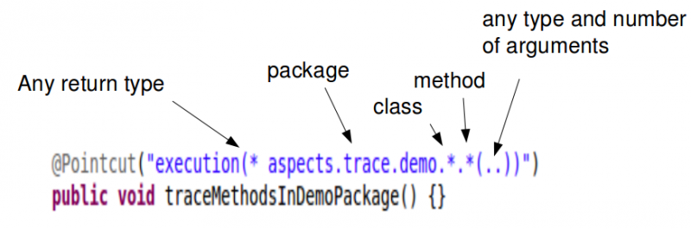
Pointcut designators

Slide 10
Logging Aspect
public void validateOrder(String orderId) {
validationService.validate(orderId);
}
public PaginatedOrderHistory getOrderHistory(String customerId) {
Customer c = getCustomer(customerId);
if (customerExists(c)) {
paginatedOrderHistory = dao.getOrderHistoryForCustomer(customerId);
}
return paginatedOrderHistory;
}
private long getOrderCount(String customerId) {
return dao.getOrderCount(customerId);
}
@Aspect
public class LoggingAspect {
@Pointcut("execution(public * *(..))")
public void publicMethod() {}
@Before("publicMethod()")
public void addLog( final JoinPoint joinPoint ) {
System.out.println("Executing: ” + joinPoint.getSignature());
}

Slide 11
Metrics Aspect
@Aspect
public class TimingAspect {
@Pointcut("execution(* *(..))")
public void allMethods() {}
@Around( "allMethods() && @annotation(Timed)" )
public Object profile( final ProceedingJoinPoint joinPoint) throws Throwable {
final long start = System.currentTimeMillis();
try {
final Object value = joinPoint.proceed();
return value;
} catch (Throwable t) {
throw t;
} finally {
final long stop = System.currentTimeMillis();
System.out.println("Execution time of ” + joinPoint.getSignature().getName() + ” was : ” + (stop-start));
}
}
}
Pointcut
Advice
@Timed
public void updateTable(Order order) {
dao.updateTable(table, order);
}
Notes:
Around – Around is a special advise you can control when a method is executed and control what to return.

Slide 12
Advantages of AOP
Modular and can be re-used
Improve productivity
Smaller code base, less code to test and maintain

Slide 13
Exercise
@Aspect
public class TimingAspect {
@Pointcut("execution(* *(..))")
public void allMethods() {}
@Around( "allMethods() && @annotation(Timed)" )
public Object profile( final ProceedingJoinPoint joinPoint) throws Throwable {
final long start = System.currentTimeMillis();
try {
final Object value = joinPoint.proceed();
return value;
} catch (Throwable t) {
throw t;
} finally {
final long stop = System.currentTimeMillis();
System.out.println("Execution time of ” + joinPoint.getSignature().getName() + ” was : ” + (stop-start));
}
}
}
public class LogAspect {

Slide 14
Exercise
@Aspect
public class PlayfulAspect {
@Pointcut("execution(* *(..))")
public void allMethods() {}
// Life is playfulness... we need to play so that we can rediscover the magical around us. - Flora Colao
// Before = play with it
// After = think of how to make it more fun
}

Slide 15
Exercise
@Aspect
public class PlayfulAspect {
@Pointcut("execution(* *(..))")
public void allMethods() {}
//Before = play with it
//After = think of how to make it more fun
}
@Before( "allMethods()" )
@Before( "allMethods() && @annotation(AtHome)" )
public void play(final JoinPoint joinPoint) {
doPlay();
}
@After( "allMethods()" )
public void thinkAndMakeMoreFun(final JoinPoint joinPoint) {
doThinkandMakeMoreFun();
}
@AtHome
public void eat(String foodId) {
doEat(eatId);
}
private void eatWithFriends(String foodId) {
doEat(foodId);
}

Slide 16
Exercise
@Aspect
public class PlayfulAspect {
@Pointcut("execution(* *(..))")
public void allMethods() {}
//Before = play with it
//After = think of how to make it more fun
@Before( "allMethods()" )
public void play(final JoinPoint joinPoint) {
doPray();
}
@After( "allMethods()" )
public void thinkAndMakeMoreFun(final JoinPoint joinPoint) {
doThinkAndMakeMoreFun();
}
}
public void eat(...) {
... ...
}
private void eatWithFriends(...) {
... ...
}
public void study(...) {
... ...
}
private void meetWithFriends(...) {
... ...
}
public void exercise(...) {
... ...
}
... ...

Slide 17
Recap
Cross-cutting concern
Aspect
Join Point
Pointcut
Advice
Playful Aspect

Slide 18
Reading
Examples
  https://blog.espenberntsen.net/2010/03/18/aspectj-examples-with-pointcuts-based-on-annotations/
Cheatsheet
  https://blog.espenberntsen.net/2010/03/20/aspectj-cheat-sheet/

Slide 19
Definitions
Join Points – points in the execution of a program. Where aspects can be applied.
  Method call, method execution, exception handler execution
Pointcut – A collection of join points.
Advice – code to be injected at join point
  Before, After, Around
Weaving – Integrating aspect to code.
  Compile time by byte-code. load-time when classes are loaded.

Slide 20
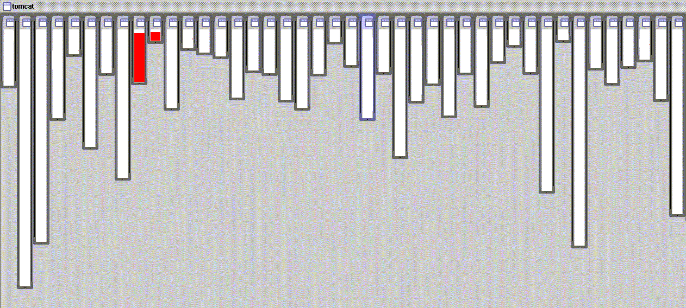
Motivation
Apache Tomcat code base
URL pattern matching
Image from AspectJ tutorial slides
URL pattern matching in org.apache.tomcat

